Slide 1



UNIVERSITY INSTITUTE OF ENGINEERING
COMPUTER SCIENCE ENGINEERING
Bachelor of Engineering
Design and Analysis of Algorithms(CST-311/ITT-311)
Topic: Dynamic Programming
DISCOVER . LEARN . EMPOWER

Slide 2
Learning Objectives & Outcomes
Objective:
To understand the importance of dynamic programming and its applications
Outcome:
Student will understand
Concept of dynamic programming
Applications of DP

Slide 3
Dynamic Programming
Dynamic Programming is also used in optimization problems. Like divide-and-conquer method, Dynamic Programming solves problems by combining the solutions of subproblems. Moreover, Dynamic Programming algorithm solves each sub-problem just once and then saves its answer in a table, thereby avoiding the work of re-computing the answer every time.
Two main properties of a problem suggest that the given problem can be solved using Dynamic Programming. These properties are overlapping sub-problems and optimal substructure.

Slide 4
Steps of Dynamic Programming Approach
Characterize the structure of an optimal solution.
Recursively define the value of an optimal solution.
Compute the value of an optimal solution, typically in a bottom-up fashion.
Construct an optimal solution from the computed information.

Slide 5
Applications of Dynamic Programming Approach
Matrix Chain Multiplication
Longest Common Subsequence
Travelling Salesman Problem

Slide 6
0-1 Knapsack
Problem Statement:
A thief is robbing a store and can carry a max_{i}mal weight of W into his knapsack. There are n items and weight of i^{th} item is w_{i} and the profit of selecting this item is p_{i}. What items should the thief take?

Slide 7
Dynamic-Programming Approach
Let i be the highest-numbered item in an optimal solution S for W dollars. Then S' = S - {i} is an optimal solution for W - w_{i} dollars and the value to the solution S is V_{i} plus the value of the sub-problem.
We can express this fact in the following formula: define c[i, w] to be the solution for items 1,2, … , i and the max_{i}mum weight w.
The algorithm takes the following inputs
The max_{i}mum weight W
The number of items n
The two sequences v = <v₁, v₂, …, v_{n}> and w = <w₁, w₂, …, w_{n}>

Slide 8
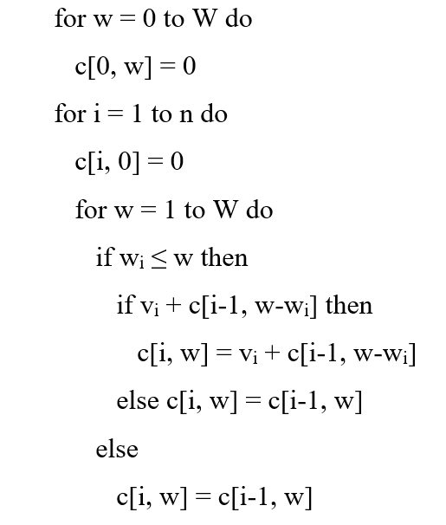
Dynamic-0-1-knapsack (v, w, n, W)

Slide 9
Dynamic Programming – Subset Sum Problem
Objective: Given a set of positive integers, and a value sum S, find out if there exist a subset in array whose sum is equal to given sum S.
Example:
int[ ] A = { 3, 2, 7, 1}, S = 6
Output: True, subset is (3, 2, 1}

Slide 10
Recursive Approach
For every element in the array has two options, either we will include that element in subset or we don’t include it.
So if we take example as int[] A = { 3, 2, 7, 1}, S = 6
If we consider another int array with the same size as A.
If we include the element in subset we will put 1 in that particular index else put 0.
So we need to make every possible subsets and check if any of the subset makes the sum as S.
If we think carefully this problem is quite similar to “Generate All Strings of n bits”
Time Complexity: O(2^{n}).

Slide 11
Dynamic Programming (Bottom –Up)
Base Cases:
If no elements in the set then we can’t make any subset except for 0.
If sum needed is 0 then by returning the empty subset we can make the subset with sum 0.
Given – Set = arrA[], Size = n, sum = S
Now for every element in he set we have 2 options, either we include it or exclude it.
for any i^{th} element-
If include it => S = S-arrA[i], n=n-1
If exclude it => S, n=n-1.

Slide 12
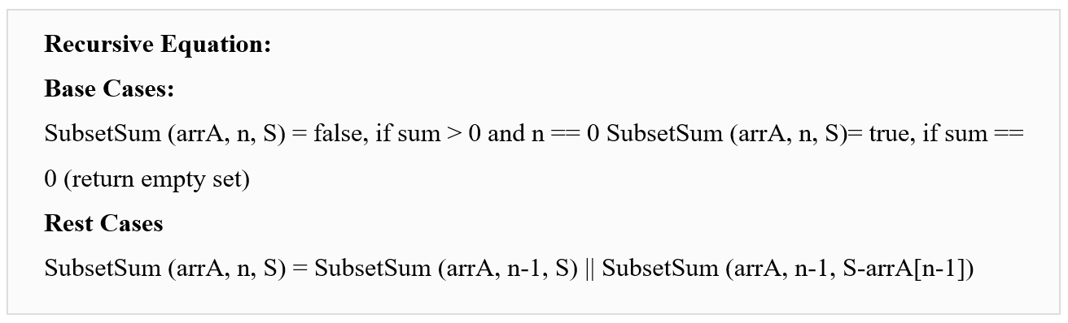

Slide 13
Change making problem/Coin Change Problem
In the coin change problem, we are basically provided with coins with different denominations like 1¢, 5¢ and 10¢. Now, we have to make an amount by using these coins such that a minimum number of coins are used.
Let's take a case of making 10¢ using these coins, we can do it in the following ways:
        Using 1 coin of 10¢
        Using two coins of 5¢
        Using one coin of 5¢ and 5 coins of 1¢
        Using 10 coins of 1¢

Slide 14
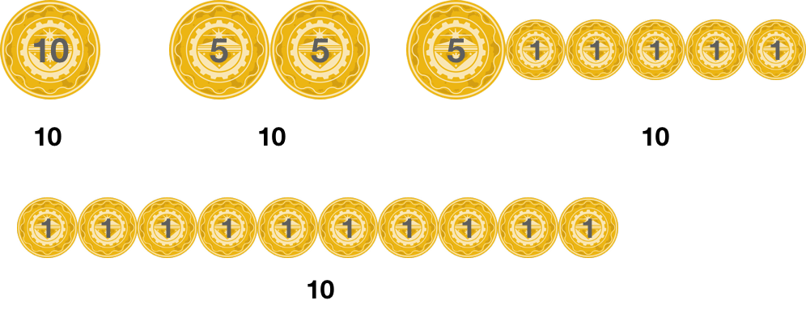

Slide 15
Approach to Solve the Coin Change Problem
Let's say Mn is the minimum number of coins needed to make the change for the value n.
Let's start by picking up the first coin i.e., the coin with the value d1. So, we now need to make the value of n−d1 and Mn−d1 is the minimum number of coins needed for this purpose. So, the total number of coins needed are 1+Mn−d1 (1 coin because we already picked the coin with value d1 and Mn−d1 is the minimum number of coins needed to make the rest of the value).
Similarly, we can pick the second coin first and then attempt to get the optimal solution for the value of n−d2 which will require Mn−d2 coins and thus a total of 1+Mn−d2.
We can repeat the process with all the k coins and then the minimum value of all these will be our answer. i.e., mini:di≤n {Mn−di+1}.

Slide 16
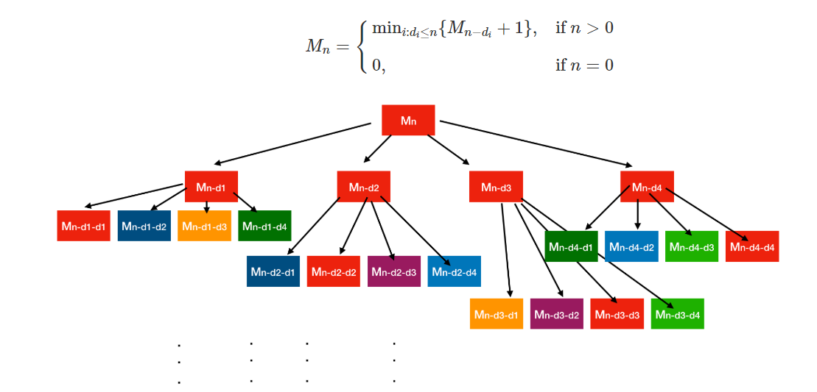

Slide 17
REFERENCES
Text books:
Cormen, Leiserson, Rivest, Stein, “Introduction to Algorithms”, Prentice Hall of India, 3rd edition 2012. problem, Graph coloring.
Horowitz, Sahni and Rajasekaran, “Fundamentals of ComputerAlgorithms”, University Press (India), 2nd edition
Websites:
https://www.tutorialspoint.com/design_and_analysis_of_algorithms/design_and_analysis_of_algorithms_01_knapsack.htm
https://algorithms.tutorialhorizon.com/dynamic-programming-subset-sum-problem/
https://www.codesdope.com/course/algorithms-coin-change/

Slide 18
Summary
  Dynamic programming:
  The general method
  0/1 knapsack
  Subset Sum problem
  Change making problem

Slide 19
THANK YOU

